Slide 1
Design Patterns
Jerry Lebowitz

Slide 2

Basis of this Lecture
Book called: Design Patterns
Elements of Reusable Object Oriented Software
Written by the “Gang of Four”
Erich Gamma
Richard Helm
Ralph Johnson
John Vlissides

Slide 3
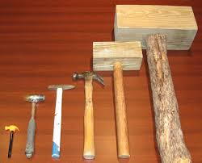
Why Use Design Patterns (1)
Design patterns are used to architect buildings and cities
Focusing on design patterns yields an architecture that is smaller, simpler, and far more understandable than if design patterns are ignored

Slide 4

Why Use Design Patterns (2)
Facilitates ways to reuse design solutions that other software developers have created for common and recurring problems leveraging the expertise of other skilled developers and designers

Slide 5

Why Use Design Patterns (3)
Designing reusable object oriented software is difficult
Designs must be specific to a particular problem and general enough to address future problems and requirements

Slide 6

Why Use Design Patterns (4)
When a designer find a solution that works well in a real-world application, they use it over and over
They rarely start from scratch
Design patterns make it easier to reuse successful designs and architectures

Slide 7

Design Patterns
Design patterns are not functions or classes
Design patterns do not provide a reusable source code component

Slide 8

The Design Approach
The design approach to solve a particular problem in a given context is reused, and the actual code to implement the design pattern is different for each particular problem
The design pattern provides a framework that is customized for each particular problem need

Slide 9

Design Patterns Benefits
Some of the benefits include:
Reduction in design time
Reduction in debugging time (sometimes quite dramatic)

Slide 10

Design Patterns Drawbacks
Some of the drawbacks include:
Sometimes a slight hit in performance of the application
An increase in the total number of classes needed for an application
In almost every case where a design pattern is used, the benefits far exceed the drawbacks

Slide 11

Four Essential Elements of a Design Patterns (1)
(1) Pattern name
A handle to describe a design problem
(2) Problem description
The problem description tells when to apply the pattern
Includes a list of conditions that must be met before it make sense to apply the pattern
It might describe classes or object structures

Slide 12

Four Essential Elements of a Design Patterns (2)
(3) Solution
The solution describes the elements that make up the design, their relationships, responsibilities and collaborations
Pattern is like a template that provides and abstracts descriptions of design alternatives

Slide 13

Four Essential Elements of a Design Patterns (3)
(4) Consequences
The consequences are the results and trade-offs of applying the pattern
Critical for evaluating design alternatives and understanding the costs and benefits of applying the pattern

Slide 14

Design Pattern Description (1)
Pattern name and classification
Intent
What does the design pattern do?
What issues does it address?
Motivation
How the classes and objects solve the problem
Applicability
Where can this pattern be used
Structure
Class diagrams

Slide 15
Design Pattern Description (2)
Participants
Classes and objects and their responsibilities
Collaborations
How the participants collaborate
Consequences
What are the tradeoffs
What aspects of the system structure can be varied
Implementation
What pitfalls, hints, etc. should one be aware of when implementing the system

Slide 16
Design Pattern Description (3)
Sample code fragments
Known uses
Examples of pattern found in real systems
Related patterns
What design patterns are related to this one
What are the important differences

Slide 17
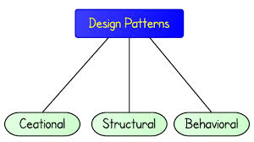
Three Categories of Design Patterns
Creational Patterns
Deals with initializing and configuring classes and objects
Structural Patterns
Deals with decoupling the interface and implementation of classes and objects
Behavioral Patterns
Deals with dynamic interactions among societies of classes and objects

Slide 18
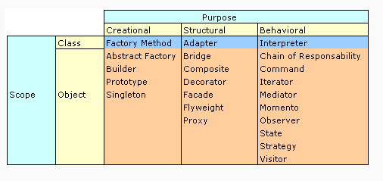

Design Patterns Categories Details

Slide 19

Creational Patterns
Abstract factory: Provides and interface for creating families of related of dependent objects without specifying concrete classes
Builder: Separates object construction from its representation
Factory method: Creates an instance of several derived classes
Prototype: A fully initialized instance to be copied or cloned
Singleton: A class of which only a single instance can exist

Slide 20
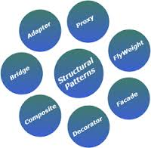
Structural Patterns
Adapter: Matches interfaces of different classes
Bridge: Separates an object’s interface from its implementation
Composite: A tree structure of simple and composite objects
Decorator: Adds responsibilities to objects dynamically
Façade: A single class that represents an entire subsystem
Flyweight: A fine-grained instance used for efficient sharing
Proxy: An object representing another object

Slide 21
Behavioral Patterns (1)
Chain of responsibility: A way of passing a request between a chain of objects
Command: Encapsulates a command request as an object
Interpreter: A way to include language elements in a program
Iterator: Sequentially access the elements of a collection
Mediator: Defines simplified communication between classes
Memento: Captures and restores an object's internal state

Slide 22
Behavioral Patterns (2)
Observer: A way of notifying change to a number of classes
State: Alter an object's behavior when its state changes
Strategy: Encapsulates an algorithm inside a class
Template method: Defers the exact steps of an algorithm to a subclass
Visitor: Defines a new operation to a class without change

Slide 23
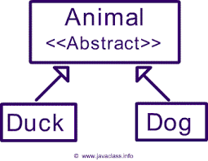
Abstract Class (as opposed to a Concrete Class)
An abstract class
Defines a common interface for its subclasses
Cannot be instantiated
Will defer some or all of its implementation to operations in the subclasses
Forces all the subclasses to carry on the same hierarchies or standards

Slide 24
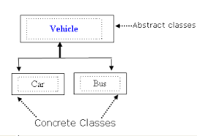
Abstract Operations
Operations that are not implemented in the base class are implemented in the subclasses

Slide 25
Creational Patterns
A class creational pattern uses inheritance to vary the classes that are instantiated
An object creational pattern will delegate instantiation to other objects
The above gives a program more flexibility in deciding which objects need to be created for a given case

Slide 26

Factory (1)
Software factory refers to a structured collection of related software assets that aids in producing computer software applications or software components according to specific, externally defined end-user requirements through an assembly process

Slide 27

Factory (2)
Software development is performed by assembling predefined components instead of using traditional IDE's
Traditional coding is left only for creating new components or services

Slide 28
Abstract Factory
Provides an interface for creating a families of related objects without specifying their concrete classes
This allows for new derived types to be introduced with no change to the base class

Slide 29
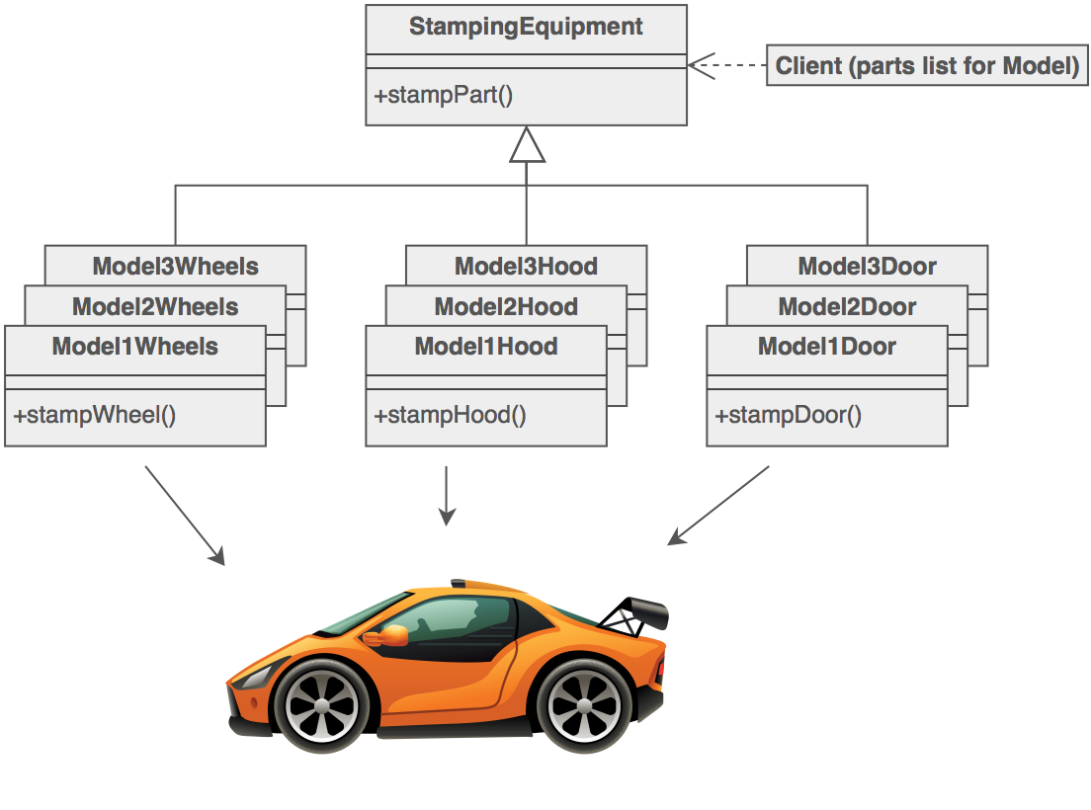
Abstract Factory

Slide 30

Abstract Factory Example (1)
An abstract factory class DocumentCreator provides interfaces to create a number of products
(createLetter(), createResume(), etc.)

Slide 31
Abstract Factory Example (2)
The software could have many derived concrete versions of the DocumentCreator class (family of classes) for example:
FancyDocumentCreator or ModernDocumentCreator
Each with a different implementation of createLetter() and createResume()
For example: Objects lilke FancyLetter or ModernResume
Each of these products is derived from a simple abstract class like Letter or Resume

Slide 32

Abstract Factory Example (3)
The client code would get an appropriate instance of the DocumentCreator and call its factory methods
Each of the resulting objects would be created from the same DocumentCreator implementation and would share a common theme (they would all be fancy or modern objects)
The client would only need to know how to handle the abstract Letter or Resume class, not the specific version that it received from the concrete factory

Slide 33
DocumentCreator
(abstract factory)
instantiates
Client
CreateLetter()
CreateResume()
Letter
(abstract product)
ModernDocument
Creator
FancyDocument
Creator
CreateLetter()
CreateResume()
CreateLetter()
CreateResume()
FancyDocument
Letter
ModernDocument
Letter
Resume
(abstract product)
FancyDocument
Resume
ModernDocument
Resume

Slide 34
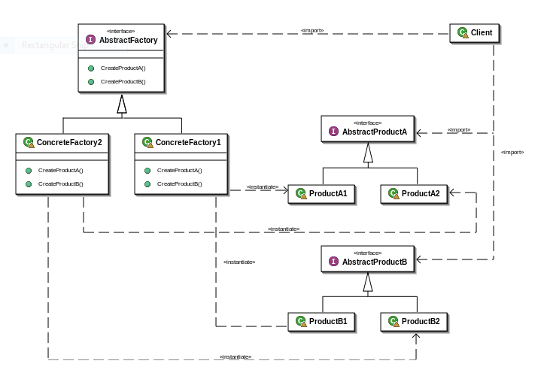
General Factory Example

Slide 35
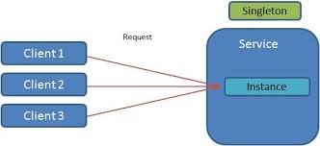
Singleton Design Pattern
Restricts the instantiation of a class to one object
This is useful when exactly one object is needed to coordinate actions across the system

Slide 36

Implementation of the Singleton Design Pattern
The singleton pattern is implemented by creating a class with a method that creates a new instance of the class if one does not exist
If an instance already exists, it simply returns a reference to that object
To make sure that the object cannot be instantiated any other way, the constructor can be made private

Slide 37
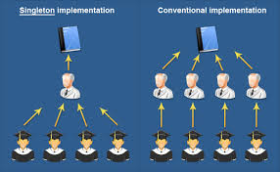
Applications of the Singleton Design Pattern
There can be many printers in a system but there should be only ONE printer spooler (controller)
There should be only ONE file system
There should be only ONE window manager
See singleton.cpp

Slide 38
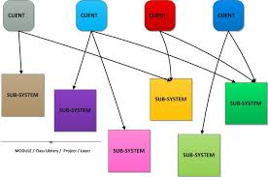
Structural Patterns
Structural design patterns are concerned with how classes and objects are composed to form larger structures
Uses inheritance
Multiple inheritance combines two or more classes into one class
Resulting class combines properties of its parent classes

Slide 39
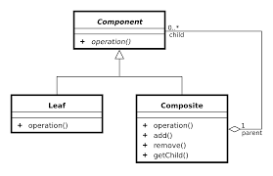
Structural Objects
Structural objects patterns describe ways to compose objects to provide new functionality
The added flexibility comes from the ability to change the composition at run-time

Slide 40
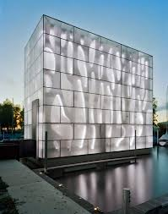
Facade Design Pattern (1)
A facade is an object that provides a simplified interface to a larger body of code, such as a class library

Slide 41
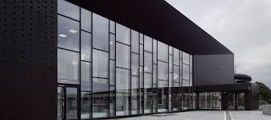
Facade Design Pattern (2)
A facade can:
Make a software library easier to use, understand and test
Since the facade has convenient methods for common tasks
Make a library more readable, for the same reason above
Reduce dependencies of outside code on the inner workings of a library
Since most code uses a facade, thus allowing more flexibility in developing the system
Wrap a poorly designed collection of APIs with a single well-designed API

Slide 42
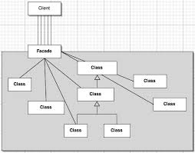
Facade Design Pattern

Slide 43
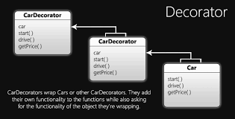
Decorator Design Pattern
Allows behavior to be added to an individual object, either statically or dynamically, without affecting the behavior of other objects from the same class
Also known as a wrapper
This is achieved by designing a new decorator class that wraps the original class

Slide 44
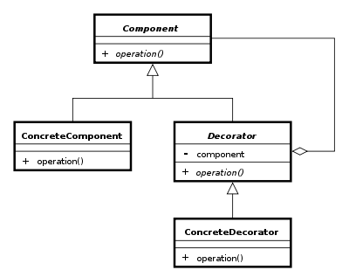
Decorator Design Patterns

Slide 45
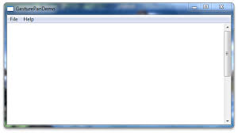
Example Decorator Design Patterns (1)
Consider a window in a windowing system
To allow scrolling of the window's contents, one may wish to add horizontal or vertical scrollbars to it, as appropriate
Assume windows are represented by instances of the Window class, and assume this class has no functionality for adding scrollbars

Slide 46
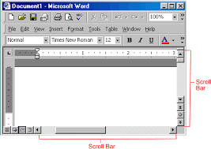
Example Decorator Design Patterns (2)
One could create a subclass ScrollingWindow that provides them, or create ScrollingWindowDecorator subclass that adds this functionality to existing Window objects
Now, assume one also desires the ability to add borders to windows
Again, the original Window class has no support
The ScrollingWindow subclass now poses a problem, because it has effectively created a new kind of window

Slide 47
Example Decorator Design Patterns (3)
If one wishes to add border support to many but not all windows, one must create subclasses WindowWithBorder and ScrollingWindowWithBorder etc.
This problem gets worse with every new feature or window subtype to be added

Slide 48
Example Decorator Design Patterns (4)
For the decorator solution, we simply create a new BorderedWindowDecorator—at runtime
One can decorate existing windows with the ScrollingWindowDecorator
Notice that if the functionality needs to be added to all the windows, one could modify the base class
On the other hand, sometimes (e.g., using external frameworks) it is not possible, legal, or convenient to modify the base class

Slide 49
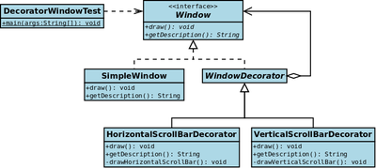
Decorator Design Patterns

Slide 50
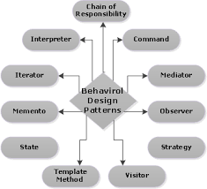
Behavior Design Patterns
Behavior patterns are concerned with algorithms and assignment of responsibilities between objects
Describes the pattern of communication between objects
Uses composition rather than inheritance

Slide 51

Template Method Pattern
The template method pattern is a software engineering design pattern describing a generic computation mechanism that can be specialized by redefining certain steps

Slide 52
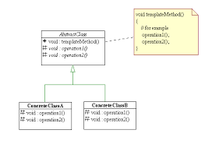
Template Design Pattern
Defines the program skeleton of an algorithm in a method, called a template method, which defers some steps to subclasses
It lets one redefine certain steps of an algorithm without changing the algorithm's structure
This use of "template" is unrelated to C++ templates

Slide 53
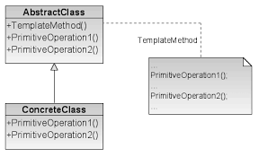
Template Design Pattern
In the template method of this design pattern, one or more algorithm steps can be overridden by subclasses to allow differing behaviors while ensuring that the overarching algorithm is still followed

Slide 54

Template Design Pattern Implementation
First a class is created that provides the basic steps of an algorithm design
These steps are implemented using abstract methods
Later on, subclasses change the abstract methods to implement real actions
Thus the general algorithm is saved in one place but the concrete steps may be changed by the subclasses

Slide 55
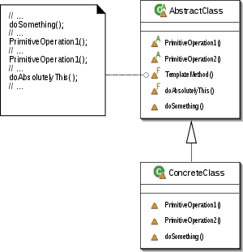
Template Design Pattern
See template.cpp

Slide 56
Generic Merging as a Template Method Pattern
One can developed a design method that mergers two sequences into one by specializing the behavior of three abstract methods (pure virtual functions)
fromA
Next element will be selected from A
fromB
Next element will be selected from B
fromBoth
Next element will be selected from both A and B

Slide 57
Generic Merging as a Template Method Pattern
template <typename E>
class Merge { // generic Merge
public: // global types
typedef std::list<E> List; // list type
void merge(List& A, List& B, List& C); // generic merge function
protected: // local types
typedef typename List::iterator Itor; // iterator type
// overridden functions
virtual void fromA(const E& a, List& C) = 0;
virtual void fromBoth(const E& a, const E& b, List& C) = 0;
virtual void fromB(const E& b, List& C) = 0;
};

Slide 58
Generic Merging as a Template Method Pattern
fromA, fromB and fromBoth
Are overridden in subclasses of Merge to achieve the desired results
Subclasses of the Merge
UnionMerge
IntersectMerge
SubtractMerge

